Slide 1
Overview
Incident response and recovering from an attack
Fundamentals of evidence collection and preservation
Basics of hard drives and other large-capacity devices
Hard drive formatting
File storage on hard drives, flash drives, and other devices
Features of major file systems used in operating systems and for removable storage

Slide 2
Incident Response (Attack?)
Verify incident (why? how?)
Gather initial evidence
volatile and meta data is important
Acquire Unaltered Image
write blocking device
proven unaltered?
Media Analysis
Minimize Data Loss, Document Everything

Slide 3
Digital Forensics
The process of collecting and/or analyzing evidence from computers and other digital storage devices (USBs, phones, etc.)
Stored Data
Volatile Data
RAM
Network Status and Connections
Processes Running
Network Data

Slide 4
The Aftermath of an Incident
Identify shortcomings in:
Risk assessment, policy, or implementation
Repair problems caused by the incident (remediation)
If the incident is caused by an individual's malicious act, and we can hold that person accountable, then we collect evidence to clearly tie the person to the incident
If someone uses our computer to violate laws, then we need to preserve evidence so that a prosecutor may use it in a trial

Slide 5
Types of Legal Disputes
Private action – one party acts against another based on a shared relationship. For example, an employer disciplines or fires an employee
Mediation – two parties rely on a third party, the mediator, to help negotiate a settlement
Civil complaint – a party files a lawsuit against another. Settled in a court trial, unless settled informally ahead of time
Criminal complaint – a person is charged with breaking specific laws

Slide 6
Admissible Evidence
When can we use informal evidence, and when must evidence be legally admissible?
Private actions and mediation
Informal evidence might be considered when resolving the complaint or dispute
Mediators might demand admissible evidence
Civil and criminal complaints
Only admissible evidence may be used in court proceedings

Slide 7
Collecting Digital Evidence
Must yield admissible evidence
Legal constraints: US 4th Amendment, expectations of privacy, private ownership, consent to search
Records collected for routine business use
No modifications since collection
The process
Securing the scene
Documenting the scene
Collecting the evidence

Slide 8
Digital Evidence Procedures
Photograph the screens of powered-on devices
For most powered-on devices, simply remove the power source – a cord and/or battery
This preserves the most evidence
May yield OS instability, but not important
If we reboot the OS, we may modify and/or destroy evidence
Document all serial numbers, cords, and other connections before removal
Seal each item in an evidence bag

Slide 9
Forensic Hard Drive Analysis
If a computer contains evidence, we do not use its native OS to analyze its contents
This changes information on the hard drive
First, we calculate an integrity check on the hard drive: a very large integer (48 digits or more)
Next, we copy the hard drive and recalculate the integrity check – it must match
Then we analyze the copy, not the original.
After we collect evidence, we recalculate the integrity check – must still match

Slide 10
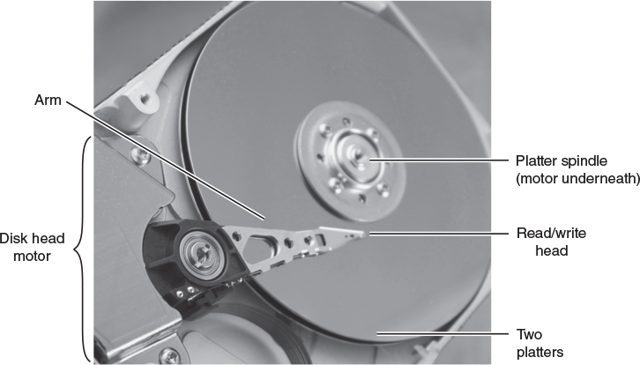
Rotational Hard Drive
Courtesy of Dr. Richard Smith

Slide 11
Data on a Hard Drive
Organized into independent blocks: sectors
Typical drives have fixed-size sectors
512 bytes each, larger on some new drives
Each sector has a unique address
Drive may read or write each sector independently – doesn't affect other sectors
Read/write time depends on location
Does the drive have to rotate to reach it?
Does the arm and head have to move?
Much slower than rotational speed

Slide 12
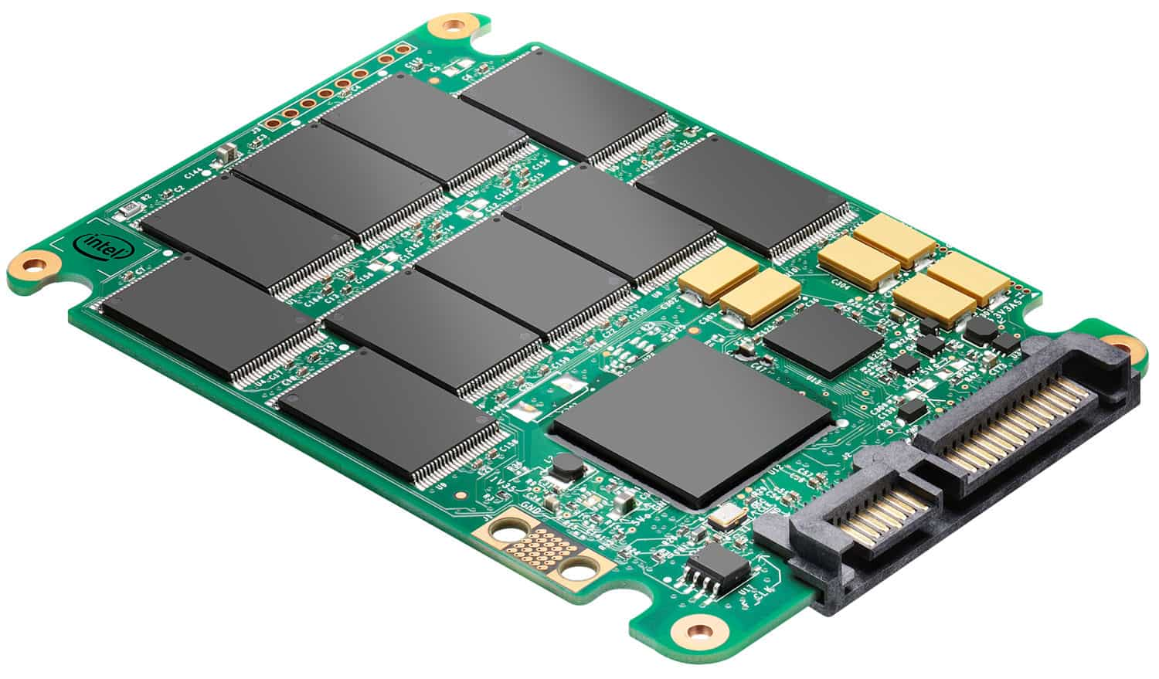
SSD (Solid State Drive)

Slide 13
Hard Drive Storage
Earliest hard drives (1950s) stored 5 MB (10⁶)
Newest hard drives store terabytes (10¹²)
Drive size has followed Moore's Law
Named for Gordon Moore of Intel
Noted that, by the mid-1960s, integrated circuits double size and performance yearly
Later refined the estimate:
Doubles every 18 months

Slide 14
Hard Drive Formatting
High-level format
Provides the structure to store files, directories, folders, and free space
Different systems use different formats
HFS on OS X, NTFS on Windows, etc.
Low-level format
Places the numbered sectors on the drive
Rewrites each one to ensure that all sectors can be read and written

Slide 15
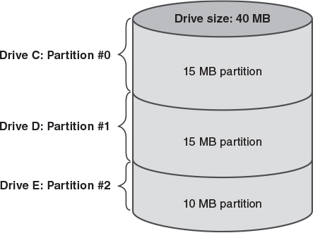
Hard Drive Partitioning

Slide 16
FAT: An Example File System
A relatively simple and widely used file system
Introduced in Microsoft's MSDOS
Supported in Windows, OS-X, Linux, etc.
Used in digital products like cameras, medical equipment, etc.
Supports many modern features
Longer, mixed-case file names
Hierarchical directories
Individual files sized up to 4GB

Slide 17
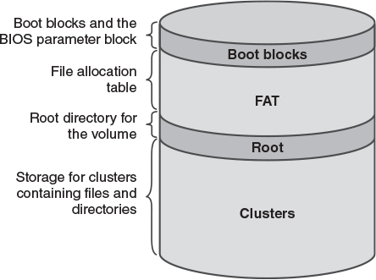
FAT Volume Layout (1 of 2)

Slide 18
FAT Volume Layout (2 of 2)
All data is stored in special areas
Boot blocks
Contain bootstrap program on bootable drive
Contains details of the volume format
How large are clusters, FAT, root directory
FAT – File Allocation Table
Locates free clusters and clusters in files
Root directory – top-level directory
Cluster storage – contains all other clusters on the drive

Slide 19
FAT Directories
Simple directory entries: One per file
File name, or special character if empty
Attributes of this directory entry
Date and time created, last read, modified
Address variable pointing to first cluster
Total number of data bytes in the file
Long file names
Constructed from a series of old-format directory entries, each holding 11 bytes of the file name.

Slide 20
FAT File Deletion
Locate the file's directory entry
Mark it as “empty”
If the file has a long file name, mark those entries as “empty” too
For each cluster in the file:
Retrieve the cluster's FAT entry
Change the entry to show the cluster is free
If there is another cluster in the file, continue
Use the same steps to delete empty directories

Slide 21
Undeleting a FAT File
Deletion simply modifies the FAT and the directory – it doesn't erase any data
Sometimes we can retrieve the file's data if:
The file's clusters were all stored in sequence on the hard drive
Another file hasn't overwritten its clusters
To undelete a FAT file:
Find the directory entry
Extract the first cluster number and length
Retrieve the series of clusters

Slide 22
FAT Has Shortcomings
File sizes limited to 4 GB
Smaller FAT systems (FAT 12, FAT 16) can't recover if errors strike the root directory
Simple directory structure slows down searches of really large directories
FAT files can't identify a file's owner
FAT files can't support access restrictions beyond very simple ones

Slide 23
Modern File Systems
Major design challenges
How to store files
How to find files
How to manage the drive's free space
Modern systems
Apple's Hierarchical File System Plus (HFS+)
Microsoft's NT File System (NTFS)
Unix File System (UFS)

Slide 24
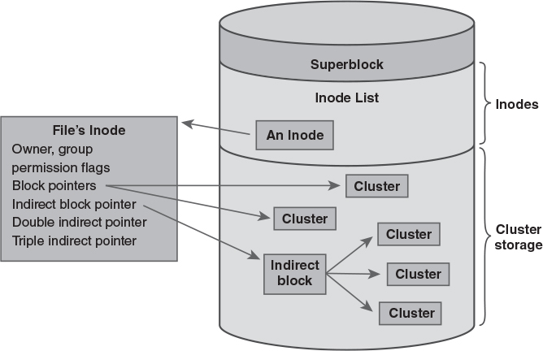
Unix File System

Slide 25
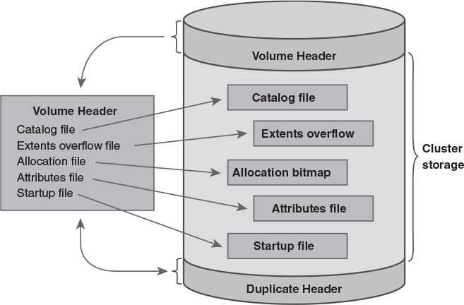
Apple's HFS Plus

Slide 26
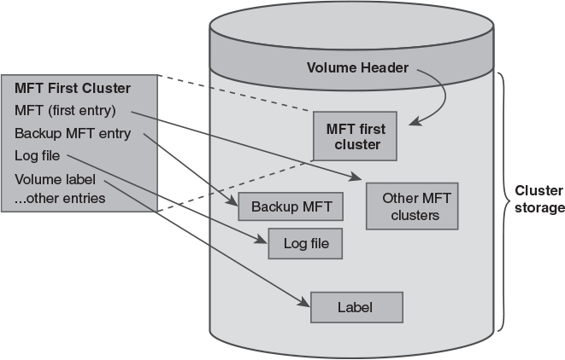
Microsoft's NTFS

Slide 27
Input/Output Systems
The operating system provides the following services to support input/output and files:
Application Programming Interface (API)
A simple, standard way for programs to use I/O devices and files
Device Independence
Converts API operations into specific commands for individual devices
File System converts file operations into API operations performed on the hard drive

Slide 28
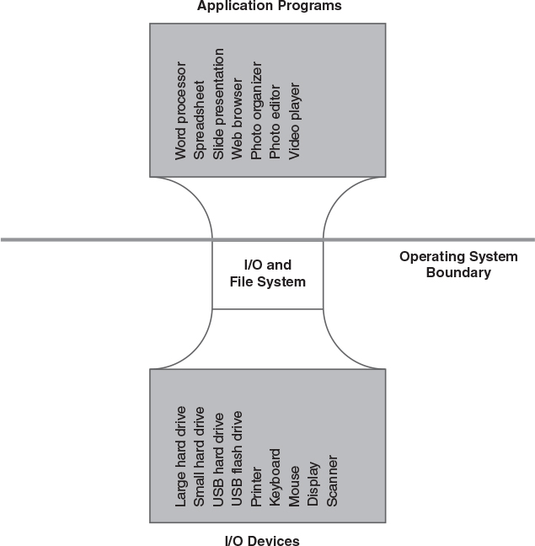
The “Hourglass” Structure

Slide 29
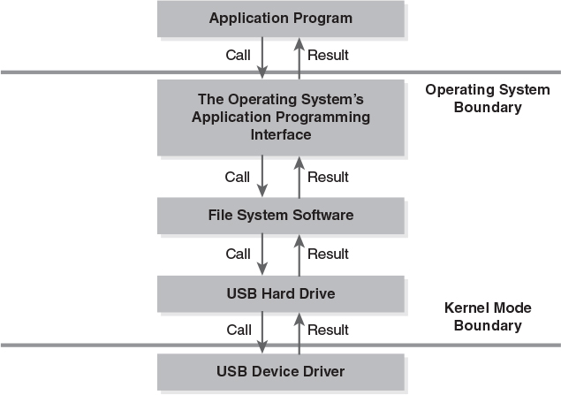
Software Layering and the File System

Slide 30
A Typical I/O Operation in Four Parts
Part A: Call the operating system
A program uses the API to read several bytes of data from a file
Part B: OS constructs the I/O operation
The file system converts the program's I/O request into a disk drive operation
Part C: The driver starts the I/O device
The hardware does its work
Part D: The I/O operation ends
The system signals that all is finished

Slide 31
Security and I/O
I/O device restrictions
Drive controllers often rely on storage registers visible in RAM or via I/O instructions
Only privileged programs can use them
Parameter restrictions on I/O operations
Process A can't do I/O to Process B's RAM
Process A can only retrieve sectors from files it has the right to access
Process A must have access rights to files it tries to read or modify

